Slide 1
OSDU Data Platform Architecture
Overview for Data Platform Architecture
Apr 2023

Slide 2
Pro-competitive Statement
Participants at this meeting shall not discuss or exchange information related to the following:
Any company’s confidential or proprietary information
Prices of products or services of a company
Purchasing plans for particular goods or services
Any company’s specific merger/divestment plans, development plans, inventories, and costs; unless this information is publicly available

Slide 3
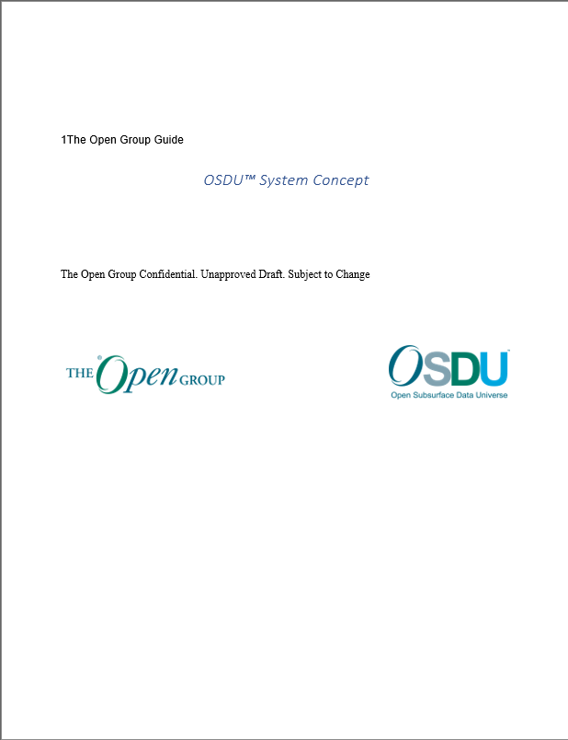
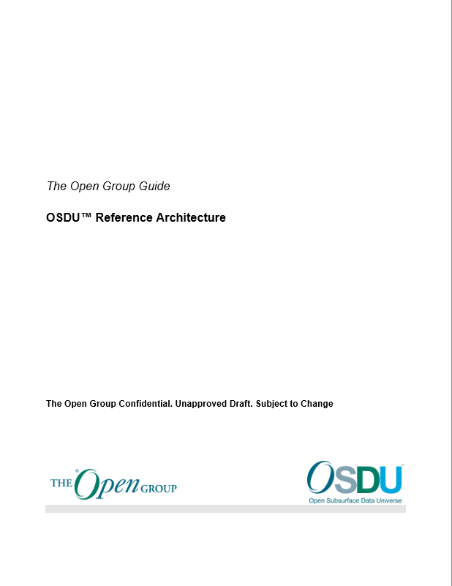
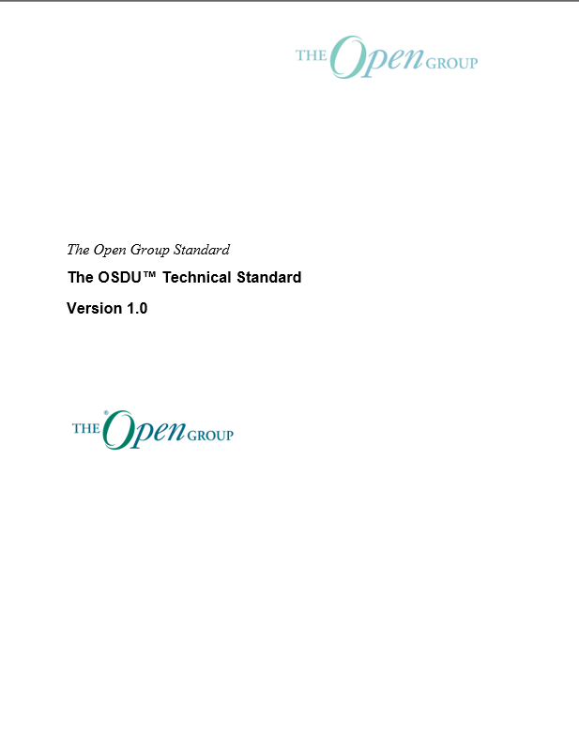
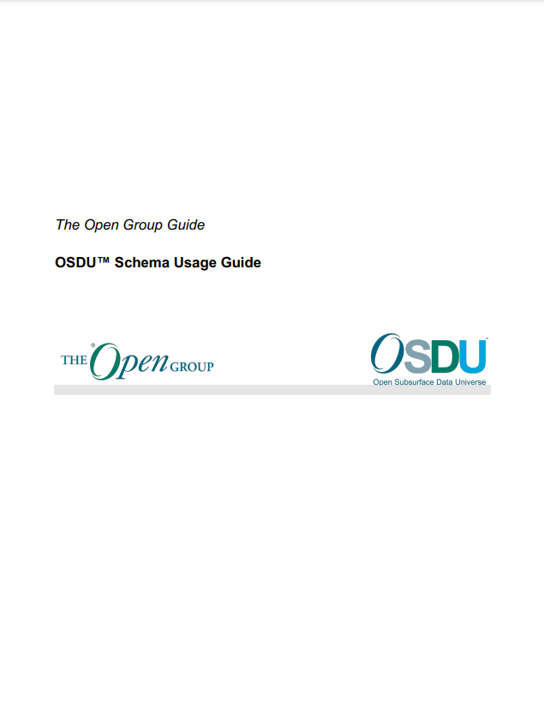
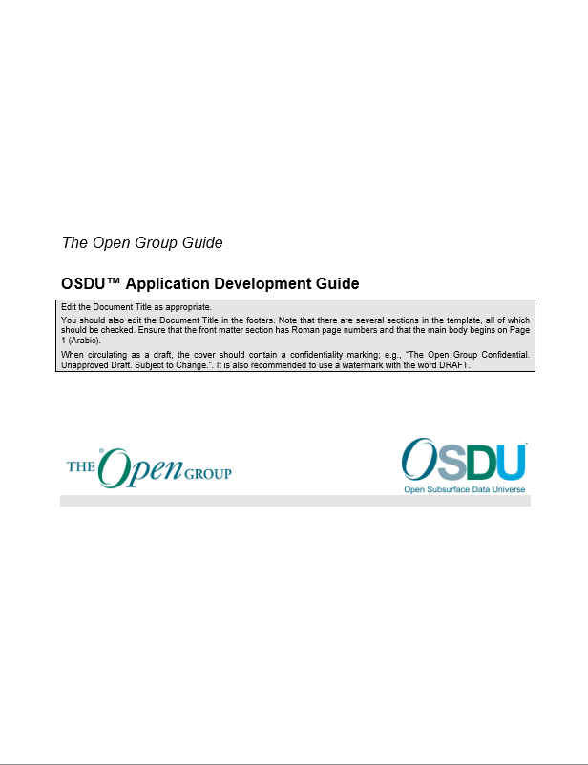
Design Space: Key Standards and Guides in OSDU
System Concept
Reference Architecture
Technical Standard
Schema Usage Guide
Application Development Guide
Business context for OSDU data platform design and implementation
Overall system architecture including design principles, data concepts, security and operations
Guidelines, requirements, and recommendations that make up the OSDU specification, so all applications can run on any OSDU Data Platform regardless of the Cloud Provider
Design of OSDU canonical schema and data definitions to ensure consistent usage in applications with goal of interoperability
ISVs and developers guide on OSDU concepts and approaches to build OSDU applications
Guide link
Ref. link
Standard link
Guide link
Guide link
https://bit.ly/3aNrPXP
https://bit.ly/3dUmIr9
https://bit.ly/3dGEUUQ
https://bit.ly/3us3TkL
https://bit.ly/3qSyRAh
NB: Links point to draft copies: published links TBC
Implementation Space Documentation is in Gitlab

Slide 4

OSDU Architecture - Data Platform
The OSDU System Concept
What, why and how
The ecosystem
Development principles
The OSDU Reference Architecture
High level patterns
Core platform
Domain specific

Slide 5
OSDU System Concept

Slide 6
What we’re doing - OSDU Mission
Using the Open Source model to promote collaboration
Working with The Open Group to create certifiable standards to support interoperability
The Open Group OSDU Forum delivers an Open Source, standards-based, technology-agnostic data platform for the energy industry that stimulates innovation, industrializes data management, and reduces time to market for new solutions.
“Polycloud” – runs on Public Clouds and on premise, taking advantage of the technology available on each
Not a data storage solution or a data management application - but a modern, cloud-native data platform
Starting in Subsurface Oil and Gas, but extending to support the wider needs of Energy Companies

Slide 7
And why we’re doing it - OSDU Vision
The OSDU Forum seeks to
reduce data silos to enable transformational workflows
accelerate the deployment of emerging digital solutions for better decision making
create an open, standards-based ecosystem that drives innovation for the energy industry

Slide 8
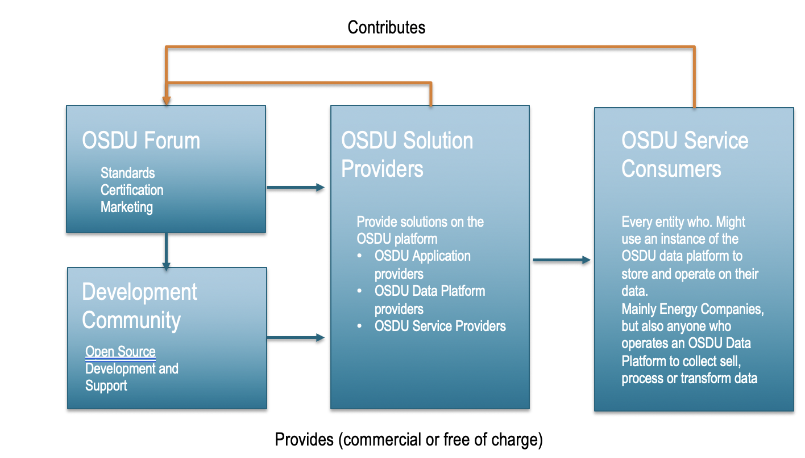
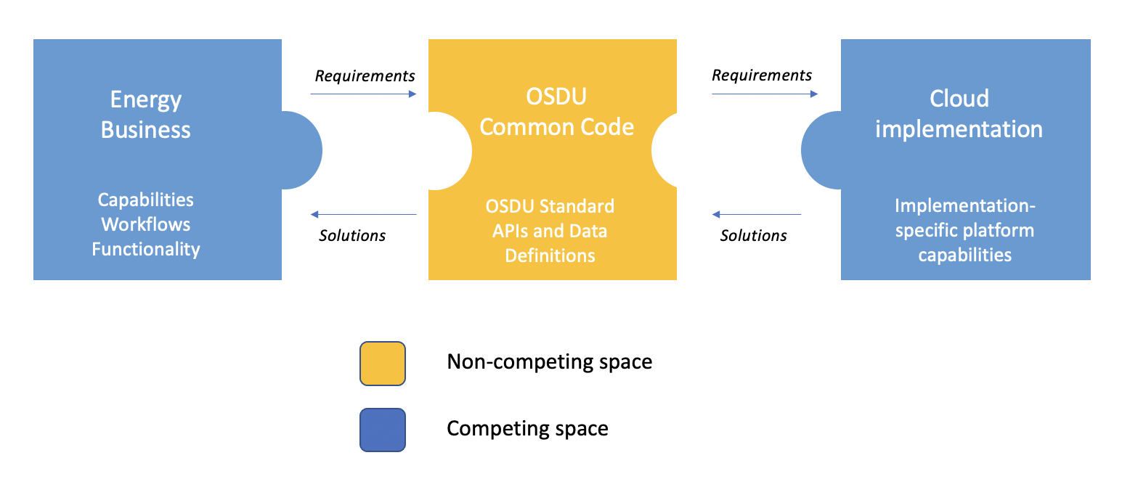
How we will achieve this
Define the compete vs the non-compete spaces
Build an ecosystem of standards, open source and commercial offerings

Slide 9
ORGANIZATION
The Open Group
The Open Group works with customers and suppliers of technology products and services, and with consortia and other standards organizations to capture, clarify, and integrate current and emerging requirements, establish standards and policies, and share best practices. The Open Group OSDU Forum Management Team ensures openness of discussion, interoperability of forum work products, no legal impediment to implementation, confidentiality of deliberations, and consensus driven decision making.
Program Director: Dennis Stevens
Associate Forum Director & Forum Support: Amanda Bonin
Focal Points
The Focal Points are led by a Chair and Vice Char and have representatives of all Member companies responsible for strategic decision making and voting on OSDU Forum matters and representing their organizations interest.
Focal points can be contacted through Slack, and the full list can be accessed here.
Forum Chair: Patrick Kelly (Chevron)
Forum Vice Chair: Jane McConnell
OSDU Management Committee (OMC)
The OMC is the 11-member tactical decision-making committee elected by the OSDU Member Focal Points to oversee the OSDU Forum.
Shared Backlog - AHA
The Shared Backlog contains all Open Source, Community, and Forum projects chartered as aligned to Capabilities. This allows for transparency and alignment of the roadmap, priorities, and progress. It also provides for ticketing of Bugs, Questions, Changes, and Ideas.
Working Groups
Working groups are established to enable collaborative definition of requirements, standards, practices, priority, roadmap, community alignment and progress toward platform and forum goals.
Project Management Committee (PMC)
The PMC governs software projects contributing to the development of the OSDU Data Platform under an Open-Source Model.

Slide 10
The roles we have defined
Role | Description
OSDU Data Platform Provider | An OSDU Data Platform Provider refers to a specific type of service provider that delivers to the market an implementation offering of an OSDU Data Platform. In some cases, an OSDU Platform Provider may perform the technical development of the platform product as well as making the product offering available for customer adoption. In other cases, the Platform Provider may simply take an existing OSDU Data Platform product offering and extend it to include additional features and functionality beyond those defined in the OSDU Standard and make this available as a new OSDU Data Platform product offering for customer adoption.
OSDU Data Platform Operator | We use the term Platform Operator to collectively refer to every entity who might use an instance of the OSDU data platform to store and operate on their subsurface and related energy data. The typical case is a major oil/gas operating company such as Shell, ExxonMobil, Chevron, etc. However, the role of Platform Operator more directly corresponds to the owner of the system and the entity ultimately responsible for it. There will be many participants in the data ecosystem who will collect, sell, process, and transform data. Any of these organizations might operate one or more instances of the OSDU Data Platform.
OSDU Data Platform Developer | The OSDU Data Platform is the foundation block for the OSDU ecosystem. The term Platform Developer refers to the OSDU Forum members who are writing common code that becomes part of the core data platform. Any member organization is eligible to contribute code toward the data platform’s functionality, as governed by the OSDU Forum.
Infrastructure Provider | Platform Operators deploy on some level of infrastructure—servers, network, databases, etc. Where they choose a public cloud, a Cloud Service Provider (CSP) provides that infrastructure. They could choose to deploy their instance in a data center—their own or that provided by an infrastructure provider.
OSDU Application Provider | Application Providers will build applications that will run on the OSDU Data Platform. An application may run externally to the platform and connect to it via the platform’s APIs, or may run as an additional service within the platform that uses and is used by other platform services or workflow orchestration services. Platform Operators often build their own applications to manage their data. Thus, in some situations, they will act in the application vendor role themselves.
Service Provider | Platform Operators often leverage the services of technology and service partners to provide functionality or to manage their technology. This is a broad category full of organizations performing many different kinds of functions. Sometimes an entity can play this role in addition to another role.

Slide 11
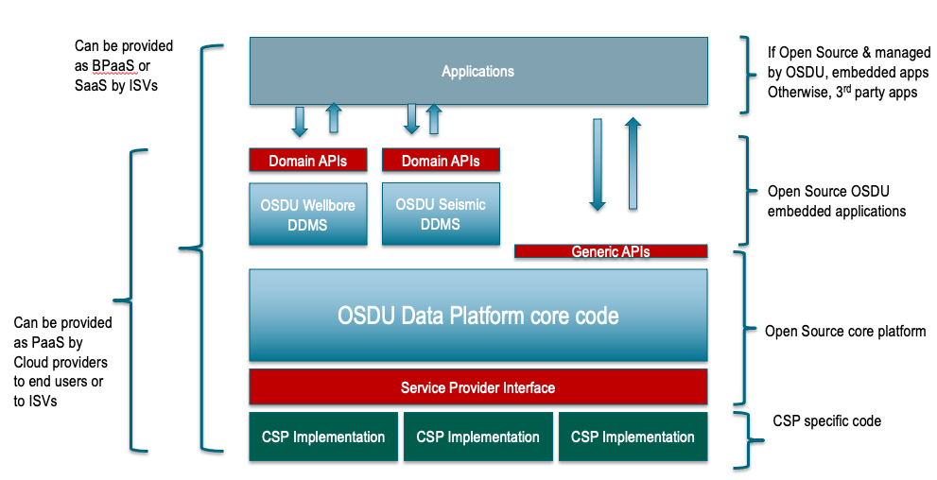
OSDU Data Platform Software Components

Slide 12
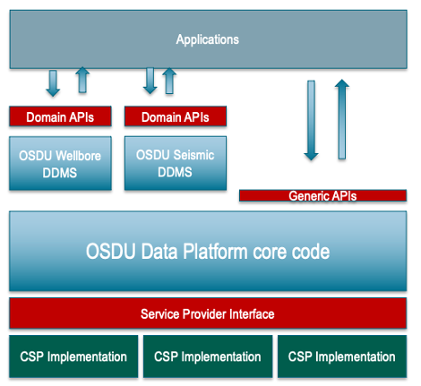
Standards Based, Energy Industry
Balancing standardising what we know, and allowing for emerging use cases
Providing both consistent behaviour through generic APIs regardless of the data domain, and performant/business rules based access within a particular domain
Knowing we will be extending out of the subsurface domain through the rest of the Energy Industry data domains
OSDU
OSDU
Custom Schemas
OSDU WKS

Slide 13
Open Source, Technology Agnostic
Apache 2.0 license for OSDU Common Code
Common Code managed through the PMC
Creation of a ”Service Provider Interface” that allows what can be common to be common, while allowing each infrastructure implementation to shine
Common Code, Open Source

Slide 14
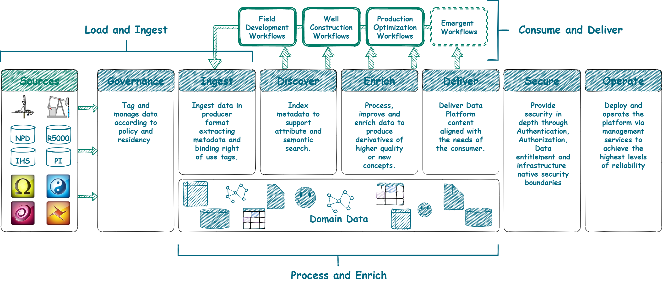
Data Platform Supporting the full lifecycle of data

Slide 15
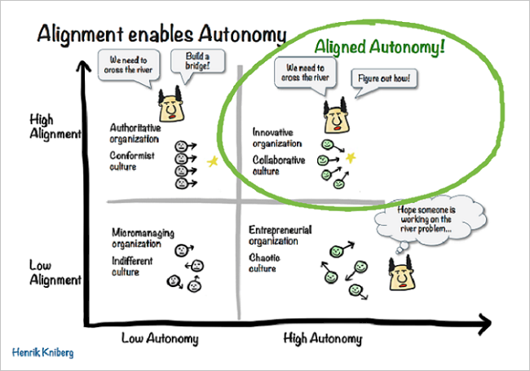
Development of Common Code – the Principles
Aligned Autonomy
Intentional Architecture, Emergent Design

Slide 16
Data principles
We value all data
Minimize friction on Data Loading and Ingestion
Don’t forget what you already know
All raw data is preserved
Data are immutable
We use data securely and responsibly
Data are access controlled
Data are governed for right of use
Data has a clear ownership
We embrace minimal viable governance
Data are globally identifiable
Data are discoverable
Data are consumable
We establish, monitor and continuously improve the quality of data
Optimize schema and quality on consumption
Improved data are new data
Data lineage is tracked

Slide 17
System Design Principles
Agility
Take a user centric approach
Microservices architecture
Aligned autonomous teams
Continuous delivery and feedback
Security
Make security everybody’s concern
Leverage cloud provider expertise
Protect data as the most valuable asset
Put customer in control of data and users
DevOps
Minimize impact to operational instances
Monitor everything important to the user
Favor managed offerings
Use robust and fault tolerant patterns
Automate at every step
Focus on few languages and frameworks
Poly Cloud
Avoid the least common denominator
Adopt community (Open Source) APIs, or develop SPI to ease portability

Slide 18
OSDU Platform Releases
Continuous development and continuous delivery is our goal
We strive to minimise major (breaking) releases
Modular design of the platform
API versioning and deprecation policy
After the initial release, new functionality will continuously be added through incremental releases
Units of functionality can be independently released

Slide 19
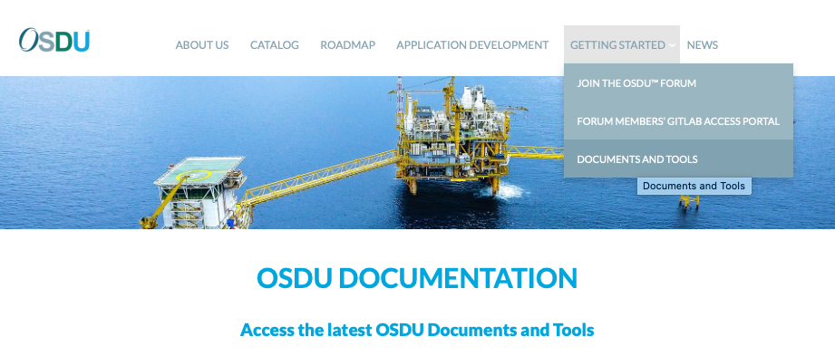
Where to find the System Concept doc
Snapshot available on the website
Or work with us – on slack at #1_10_ea_technical_docs

Slide 20
Purpose of a Data Domain?
There are currently two purposes of the Data Domains
Ease Accessibility
Domains will be used to catalogue the increasing number of Data Types (Reference, Master & WPC)
Assist Governance
Owning Domain
The Domain for which it is accountable for the data (e.g., Data Types, Generic APIs, DDMS, etc.) on which it and other Domains rely.
Know where to go for in depth knowledge of a Data Type
Using Domains
Capturing the Domains that access / use Data Types for the purpose of delivering the capabilities of that Domain
Know who could be impacted if a change to a Data Type is required

Slide 21
Data Domains
Currently we have defined two levels of Data Domains (Subject Areas L1 & Domains L2)
L1 – Subject Areas
Subject Area (L1) | Definition
Generic | This subject area includes all the data categories which are transverse to the whole specialized data domains. This holds all the entities which have a lifecycle independent of any business domain – as being related to the platform operations, to the “supports” of the business (finance, HR,….) or as being inherited from the routine (countries, UoM,…)+
Subsurface | Data about or related to something located or introduced beneath the surface of the earth.
Well | A proposed, permitted or actual drilled hole in the ground designed to exchange (or facilitate the exchange of) fluids between a subsurface reservoir and the surface (or another reservoir), or to enable the detection and measurement of rock properties.
Surface Facilities | A facility is defined as being a piece of equipment, a collection of pieces of equipment, or a role that a piece of equipment plays. Facilities are required to handle any kind of energy sources, to transform, store, transfer them. These facilities can be everything from gas processing plants and batteries to pumps, metering station, and pipelines. The facility is an assembly of equipment, assembled to perform a physical or chemical process. A facility represents the high-level function to be performed and is decomposed in process units
Production | (Production) applies to all forms of material, fluid or energy production or generation, such as those from conventional hydrocarbons, material mining, mineral production, or renewable sources. It also includes fluid injection or disposal (such as water injection or disposal, or carbon dioxide injection as part of CCUS activities). Production encompasses details about the entities involved, output quantities, the method of production and distribution, and information on the extraction, injection or generation process.

Slide 22
Data Domains
Currently we have defined two levels of Data Domains (Subject Areas L1 & Domains L2)
Level 1 – Subject Areas
Subject Area (L1) | Definition
Generic | This subject area includes all the data categories which are transverse to the whole specialized data domains. This holds all the entities which have a lifecycle independent of any business domain – as being related to the platform operations, to the “supports” of the business (finance, HR,….) or as being inherited from the routine (countries, UoM,…)+
Subsurface | Data about or related to something located or introduced beneath the surface of the earth.
Well | A proposed, permitted or actual drilled hole in the ground designed to exchange (or facilitate the exchange of) fluids between a subsurface reservoir and the surface (or another reservoir), or to enable the detection and measurement of rock properties.
Surface Facilities | A facility is defined as being a piece of equipment, a collection of pieces of equipment, or a role that a piece of equipment plays. Facilities are required to handle any kind of energy sources, to transform, store, transfer them. These facilities can be everything from gas processing plants and batteries to pumps, metering station, and pipelines. The facility is an assembly of equipment, assembled to perform a physical or chemical process. A facility represents the high-level function to be performed and is decomposed in process units
Production | (Production) applies to all forms of material, fluid or energy production or generation, such as those from conventional hydrocarbons, material mining, mineral production, or renewable sources. It also includes fluid injection or disposal (such as water injection or disposal, or carbon dioxide injection as part of CCUS activities). Production encompasses details about the entities involved, output quantities, the method of production and distribution, and information on the extraction, injection or generation process.
More Subject Areas and Domains will be added as required

Slide 23
Data Domains
Level 2 – Domains (Extract)
Subject Area | Domain | Domain Definition
Generic | Legal Agreement | Covers current and historical information about authorization or consents to undertake operations or business activities. . This can be referred as License, Contract, Lease, Concession and allows to track detailed information about the contents of applications, documents or other material submitted as supporting materials and relationships to any licenses or consents received as a result
 | Data Quality | Covers all management aspects of the degree of usability of the enterprise’s data, including analysis and metrics, accuracy, assurance, governance, completeness and corrective/sustaining actions.
 | Entitlements | Covers the issues relating to data access and security – which enables users to control of access to data, and what can be done with it.
 | Environment | Covers the surroundings in which an entity operates, including air, water, land, natural resources, flora, fauna, humans and their interrelation.
 | Location | Describes the geodetic data (coordinates, datum, projection system) and the definition and data structures for geographically and/or political bounded areas.
 | Organisation | It is a company, person, consortium or regulatory body such as a jurisdiction, agency or government department.
 | Process Safety | A disciplined framework for managing the integrity of operating systems and processes handling hazardous substances by applying good design principles, engineering, and operating practices. (AiCHE)
 | Project/Activity/Study Lifecycle | Represents generic activities, projects, studies including involvements with data, physical facilities, business associates, etc.
 | Catalogs | Universal reference data that is not specific to a particular domain.
Subsurface | Geology / Petrophysics | The physical history of the earth and its life as recorded in the rocks, including petrophysical measurements.
 | Geophysics | The physics of the Earth, especially its electrical, gravitational and magnetic fields and propagation of elastic (seismic) waves within it.
 | Reservoir | A network of porous and permeable subsurface rock bodies that store and transmit fluids within a natural pressure system.

Slide 24
Documenting Domains in OSDU
Draft
The dependencies dataset can conveniently contain the domain associations
Using DependenciesAndRelationships.json to document the Domain association
Domain Association string highlighted in Blue “EntityName.1.0.0": {
"dependencies": [],
"entity_name": "EntityName ",
"group": “GroupType",
"inherited_from": [],
"kind": "osdu:wks: EntityName :1.0.0",
“x-osdu-domains”: [main Domain, Used by Domain 1, Used by Domain 2, …]
"relations": [
{…
}
There will be a Domain reference-data entity that will contain the list of valid domains
Possible reference-data entity: OSDUDataDomain

Slide 25
Reference Architecture High Level

Slide 26
High Level Architecture Patterns Microservices + Event Sourcing + Domain Driven Design
Bounded Context
Storage
SPI
CSP Object Store

Slide 27
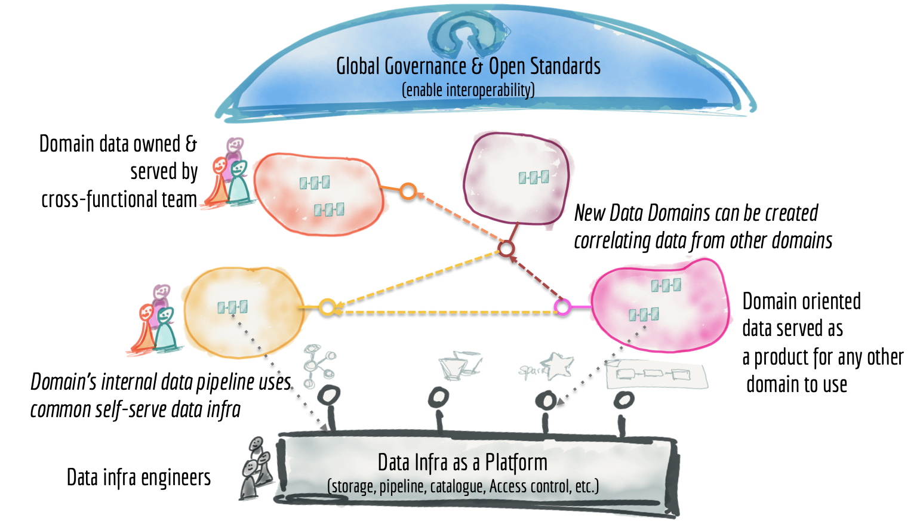
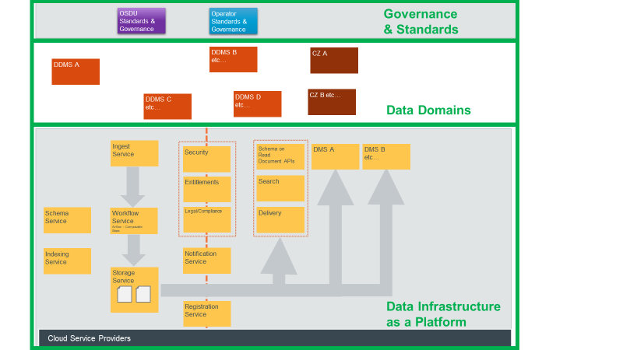
High Level Architecture Patterns Data Mesh
https://martinfowler.com/article/data-monolith-to-mesh/data-mesh.png
https://martinfowler.com/articles/data-monolith-to-mesh.html

Slide 28
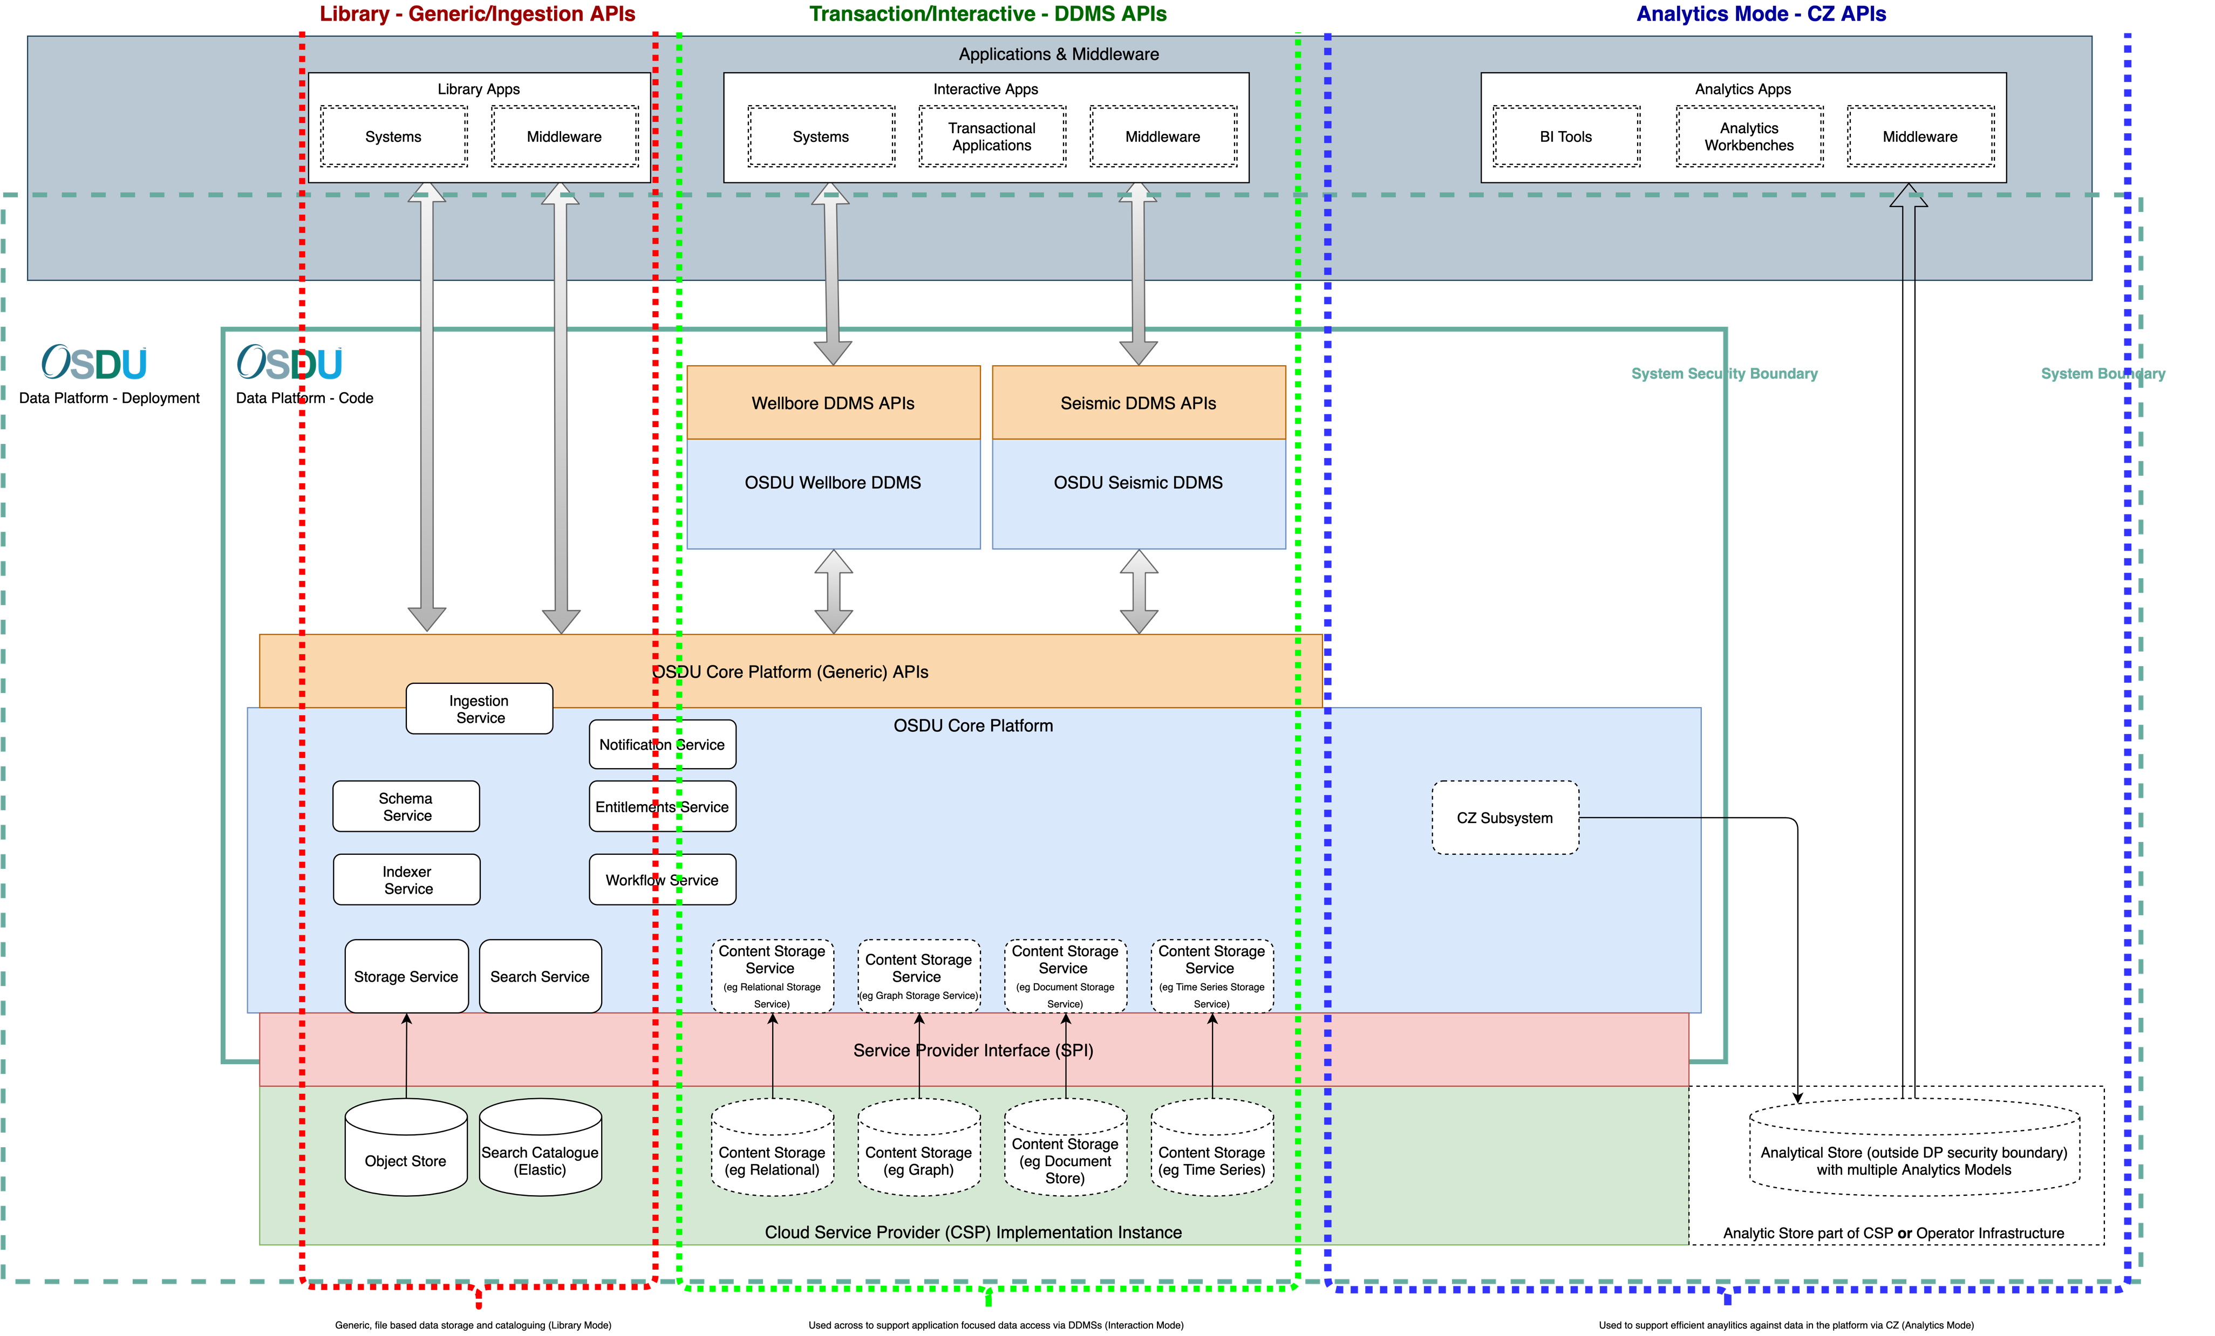
High Level Architecture

Slide 29
Security
Security is a fundamental part of the platform
Data accessed though ‘secure urls’
Entitlements and Obligations (policy-based security) on roadmap

Slide 30
Data Governance
Schema focused on community-driven “Well Known Schema” for data discovery
Can be extended and customised
Data is immutable within the system

Slide 31
Data
Any (document) data can be added to the system (Data lake/object store pattern)
Master data is just data
Strongly typed, more opinionated data models and access through other interfaces and components in the platform…
External Data Services (EDS) enable external data to be catalogued and used by the platform

Slide 32
Overview of schemas
https://gitlab.opengroup.org/osdu/subcommittees/data-def/work-products/schema/-/tree/master
reference-data​
Each type defines a ‘Catalog’ of values.
master-data
Well, Wellbore
Project, Survey, Agreement
work-product-component​
measurements
observations
dataset​(https://community.opengroup.org/osdu/data/data-definitions/-/tree/master/E-R)
File​
FileCollection

Slide 33
Search
Platform Search
The platform search service allows data to be discovered across the platform
Indexer Service and Schema
Uses ElasticSearch
DDMS Deep Search

Slide 34
Ingestion and Workflow
Ingestion of data into the platform through Ingestion Service(s) which ensure data is correctly catalogued and indexed
Workflow service allows data to be transformed, conformed and enriched within the platform
Common capability which can be reused across the platform

Slide 35
Pulling Data Into Other Components
Push (using Workflow Service)
Pull (pub/sub using Notification Service)

Slide 36
Helper Service
CRS Converter
convert/transform a list of points between two defined CRSs
Trajectory Converter
trajectory computation and spatially correct placement
Point Converter
array handling 'utility'

Slide 37
OSDU Domain Data Mgmt Services - Context

Slide 38
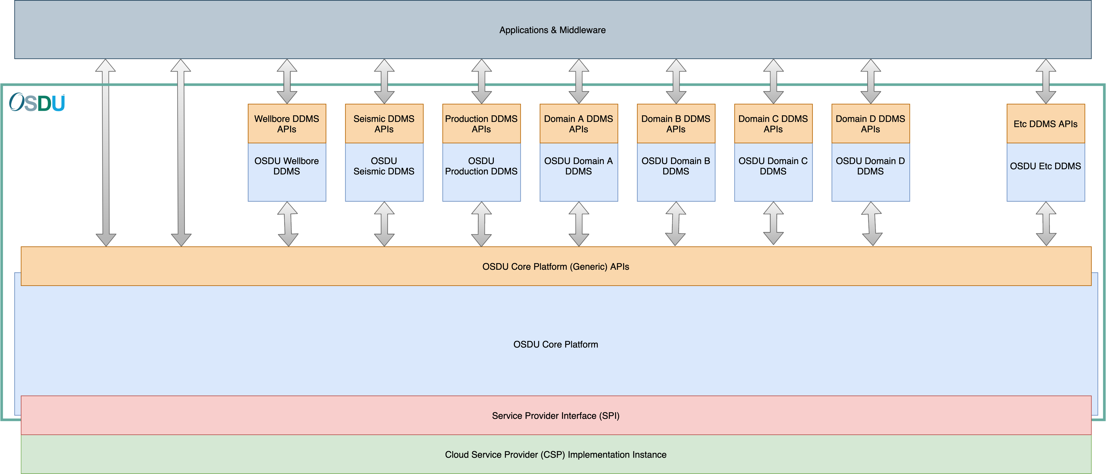
DDMS – More Domains

Slide 39
Transaction Mode - Domain Data Management System (DDMS)
A service that persists data of a specific domain and provide access through optimized domain APIs.
It is governed by overall platform but is developed and evolved independently.
Reuses the core platform services for identity, lineage, security, discoverability and data flow
A DDMS is a set of:
Highly optimized storage & access for data, with highly opinionated API’s delivering the data required to enable domain workflows
Strongly governed schemas that incorporates domain-specific perspective and type-safe accessors for registered entity types
DDMSs follow Domain Driven Design Principles…

Slide 40
Content Storage Services (CSS)*
Future State
CSSs allow different shapes of data to be stored and processed in the platform
Conceptual in the Mercury release (File)
Future releases may introduce other CSS (e.g. Graph, Relational) to rationalise DDMS usage of similar capabilities
* Previously called DMS

Slide 41
OSDU Consumption Zones - Context

Slide 42
Analytics Mode - Consumption Zones
Future State
Consumption Zones
provide read only access to platform defined, subsets of data
are outside the security boundary of the system
Conceptual in R3, Consumption Zone being worked on for the Geospatial and Operator Dashboard projects

Slide 43
Backup

Slide 44
Current Status of Platform Services and APIs
OSDU API
OSDU Platform Layer
OSDU
Data Platform
Ingestion Services
Consumption Services
Enrichment Services
Well known schema service
MS Azure
Workflow Service
Data Set/File
Search
Framework
Data Services
Parsers
Workflows
Indexer
Enrichment
OSDU
Platform
Layer
Domain DM Services
Core Services
Policy based Entitlements & Obligations
Helper Services
Wellbore
Seismic
Schema
Compliance
Notification
CRS
GCP
MS
IBM
Platform Services
Storage
Entitlements
Registry
Units
Service Provider Interface
Multi-region
AWS
R3 Essence
Provider
Technologies
Other Stores
Document Store
Blob Store
Elastic Search
Canary
Extensions
Provider Operations

